Slide 1

INTRO TO DATA SCI & AI
SC1015 - FCS2
Contributor: Darre, Yeow Keng, Jared

Slide 2



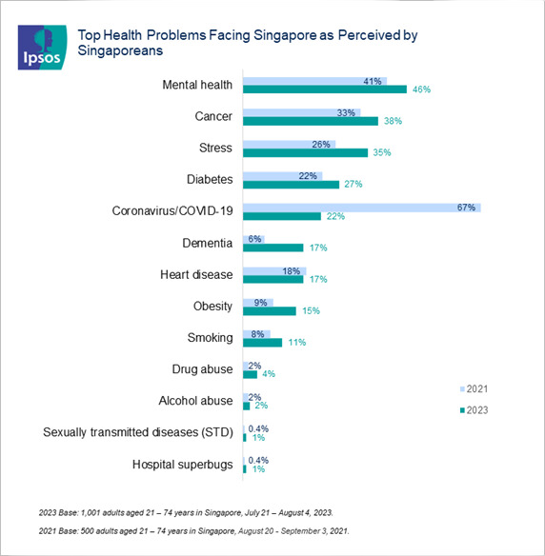
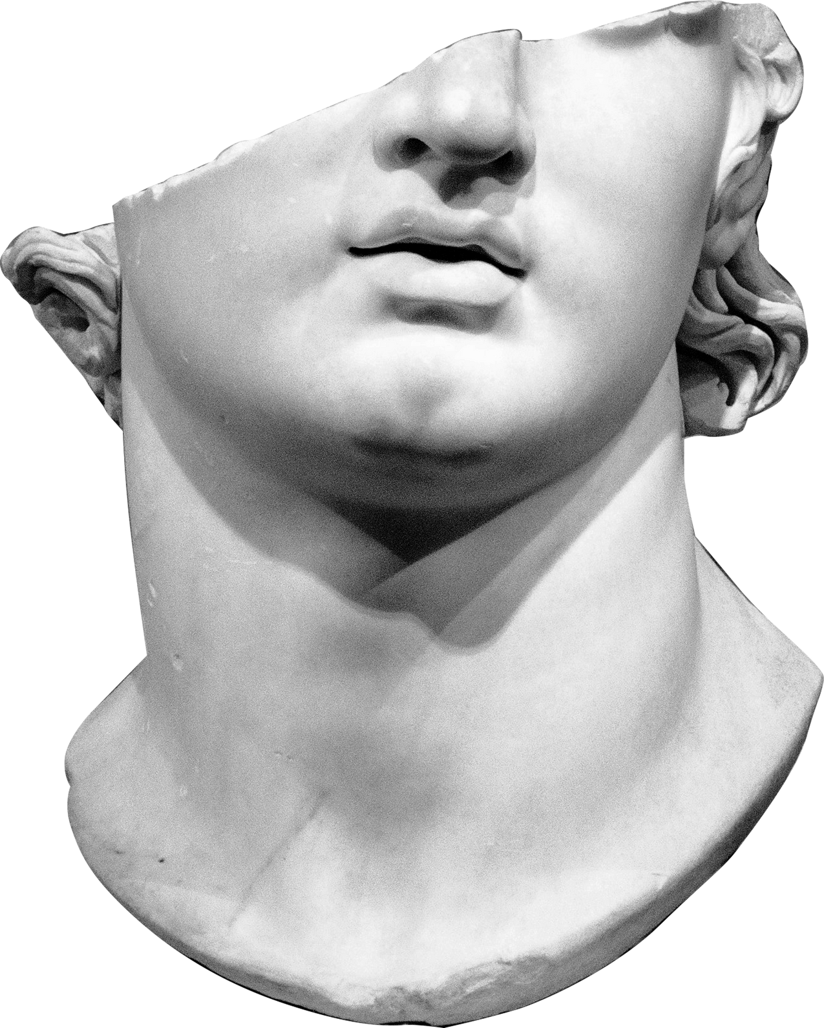
INTRODUCTION
In Singapore, a survey by found that 46% of the population perceives mental health as the largest health concern
How can we better identify early symptoms with AI?
FOR PEACE, BALANCE, AND MENTAL CLARITY

Slide 3
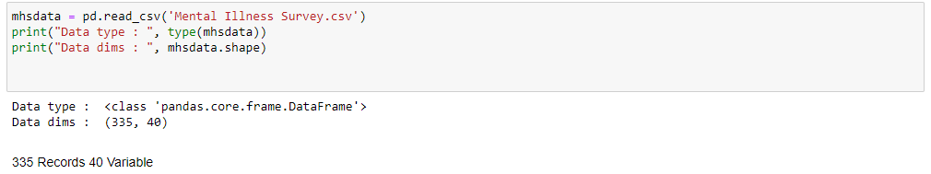

Dataset
Surveys focused on unemployment and mental illness
The dataset includes individuals both with and without mental health conditions, categorized with 'yes' and 'no' indicators
Records : 334
Notes:
For this project, we will utilize datasets sourced from Kaggle, comprising surveys focused on unemployment and mental illness. The dataset includes individuals both with and without mental health conditions, categorized with 'yes' and 'no' indicators, with a total sample size of 334.

Slide 4
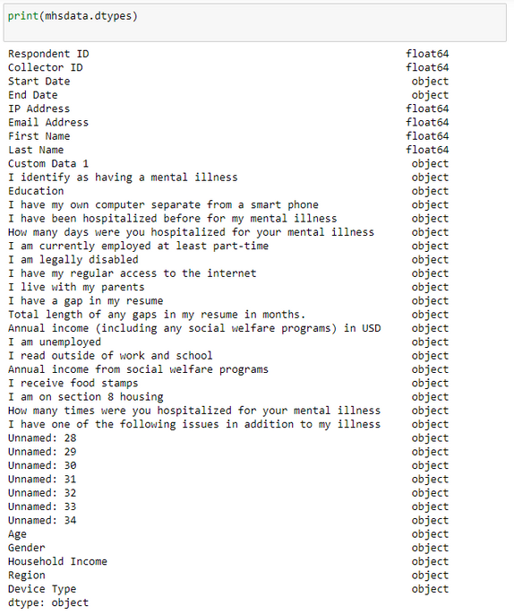
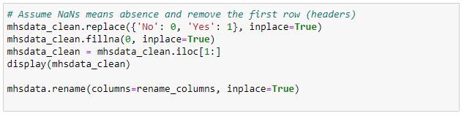
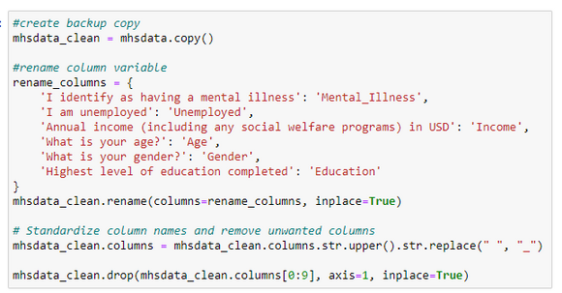
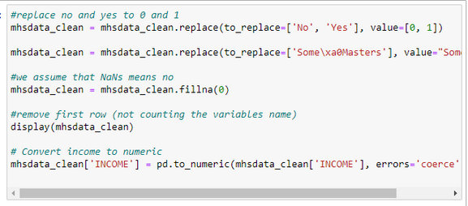
Exploratory Analysis and Data Preparation
We began by cleaning the dataset, standardizing features name, replace missing data with 0, convert categorical data type to numeric and removing features deem unhelpful for our findings.
Notes:
Upon analyzing the features type and entries. We had to standardize the features name and replace missing data with 0 with the assumption of the person not having problem related to the feature. Also, we removed features that are deem not helpful to our analyses and replace category data to numeric for example male and female to 1 and 0.

Slide 5
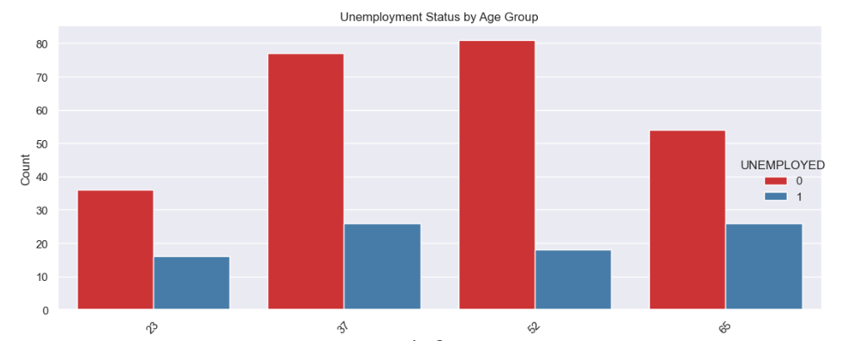
Exploratory Analysis and Data Preparation
We partitioned our dataset into two distinct segments: one focusing on unemployment and the other on mental illness
Notes:
We partitioned our dataset into two distinct segments: one focusing on unemployment and the other on mental illness. This division empowers us to delve deeper into each aspect individually, facilitating a more comprehensive analysis. Leveraging barplot, we crafted two sets of graphs. The first set depicts age group on the x-axis against count on the y-axis with color red and blue indicating different employment status, allowing us to assess the potential influence of age on employment. The second set illustrates education level on the x-axis against count on the y-axis, with color green and orange indicating different employment status. This approach enables us to explore the intricate relationships among education level, age, employment status, and mental health.

Slide 6
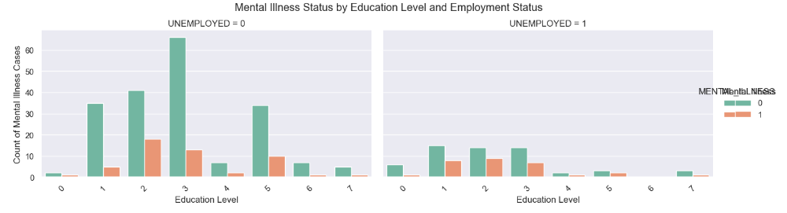
Data Visualization
Notes:
We partitioned our dataset into two distinct segments: one focusing on unemployment and the other on mental illness. This division empowers us to delve deeper into each aspect individually, facilitating a more comprehensive analysis. Leveraging barplot, we crafted two sets of graphs. The first set depicts age group on the x-axis against count on the y-axis with color red and blue indicating different employment status, allowing us to assess the potential influence of age on employment. The second set illustrates education level on the x-axis against count on the y-axis, with color green and orange indicating different employment status. This approach enables us to explore the intricate relationships among education level, age, employment status, and mental health.

Slide 7
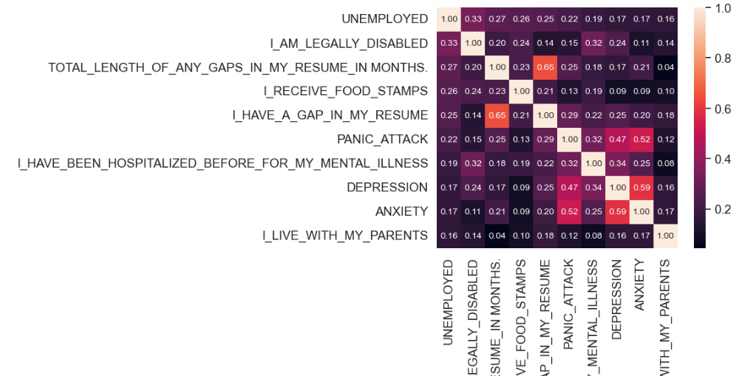
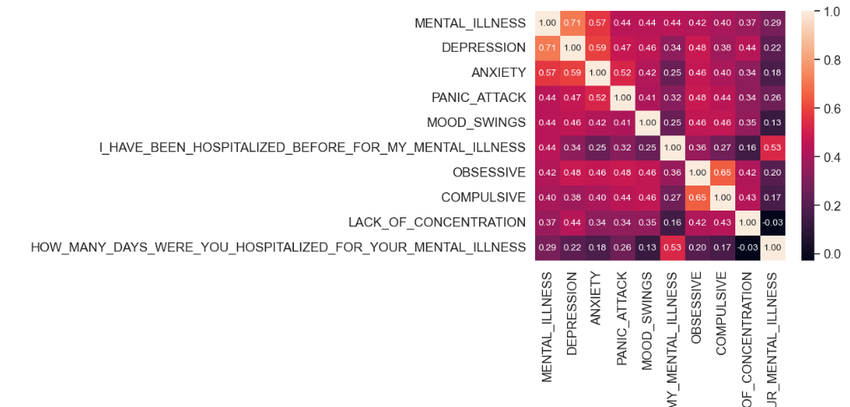
Features Correlation
Notes:
With the available information, we aimed to discern the relationships between variables in the dataset. Employing a correlation matrix, we sought to identify strong, weak, and non-existent relationships between features. However, the initial correlation matrix proved too generic to address the specific issues pertaining to mental health and unemployment. Consequently, we generated two separate correlation matrices to pinpoint the top 10 features with strong relationships to mental illness and employment, respectively.

Slide 8

Machine Learning
Notes:
After analyzing the coefficient matrix data, we employed five different models—random forest, logistic regression, decision tree, neural network, and SVM—to forecast mental illness.

Slide 9
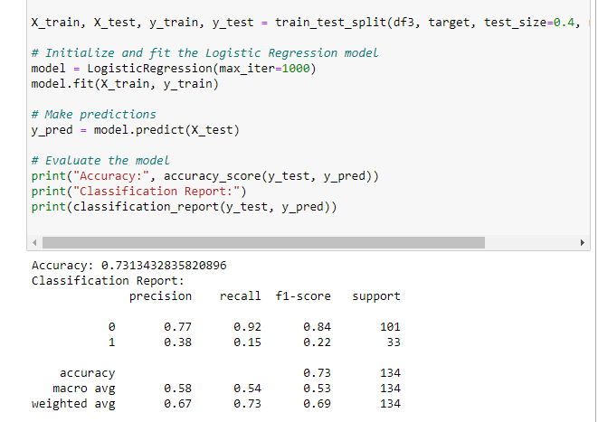
Logistic Regression
The Logistic Regression model initially achieved an accuracy of 0.73, accurately predicting 73.13% of all cases in the test dataset. However, it displayed limitations in accurately predicting the "Employed" class.
Notes:
Transitioning to the logistic regression model, it initially achieved an accuracy of 0.73, accurately predicting 73.13% of all cases in the test dataset. However, it displayed limitations in accurately predicting the "Employed" class.
Through adjustments to the threshold, precision for predicting "1" (or "Employed") increased from 0.43 to 0.75. Nevertheless, this enhancement in precision came at the expense of a decreased recall, suggesting that while predictions became more accurate, a significant number of actual employed cases were missed.
By considering the F1 score, a balance between precision and recall was achieved. The model now exhibits a higher recall rate of 0.6875 but a lower precision of 0.333 at the threshold of 0.192. This threshold prioritizes identifying true positives due to the higher recall rate, albeit at the expense of an increase in false positives due to the lower precision.

Slide 10
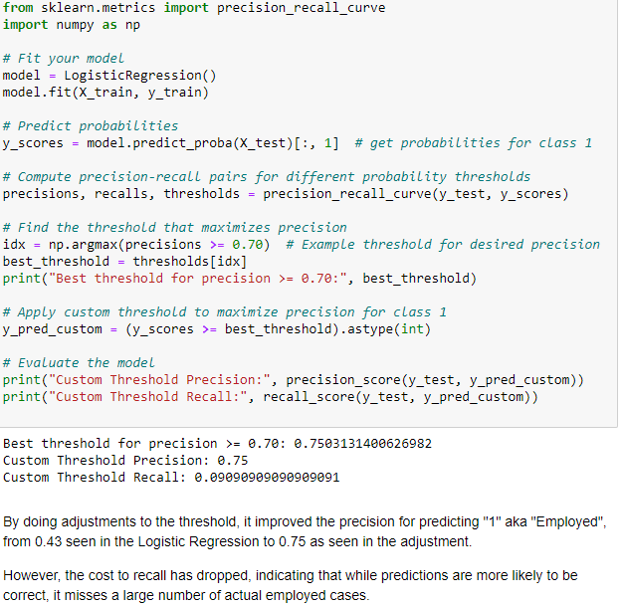
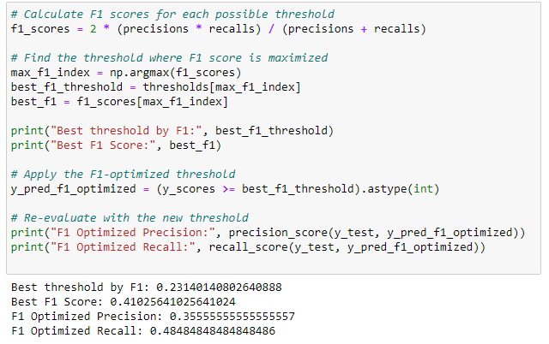
Logistic Regression
Through adjustments to the threshold, precision for predicting "1" (or "Employed") increased from 0.43 to 0.75. Nevertheless, this enhancement in precision came at the expense of a decreased recall, suggesting that while predictions became more accurate, a significant number of actual employed cases were missed.
Notes:
Transitioning to the logistic regression model, it initially achieved an accuracy of 0.73, accurately predicting 73.13% of all cases in the test dataset. However, it displayed limitations in accurately predicting the "Employed" class.
Through adjustments to the threshold, precision for predicting "1" (or "Employed") increased from 0.43 to 0.75. Nevertheless, this enhancement in precision came at the expense of a decreased recall, suggesting that while predictions became more accurate, a significant number of actual employed cases were missed.
By considering the F1 score, a balance between precision and recall was achieved. The model now exhibits a higher recall rate of 0.6875 but a lower precision of 0.333 at the threshold of 0.192. This threshold prioritizes identifying true positives due to the higher recall rate, albeit at the expense of an increase in false positives due to the lower precision.

Slide 11
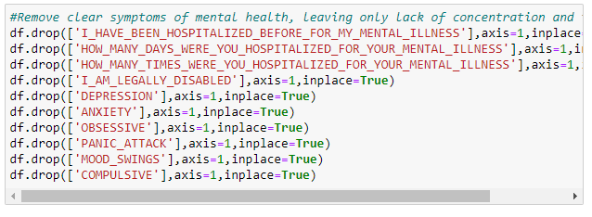
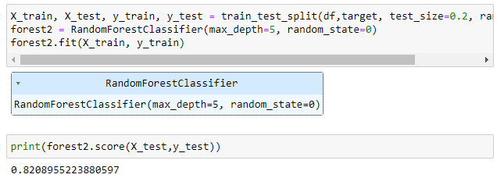
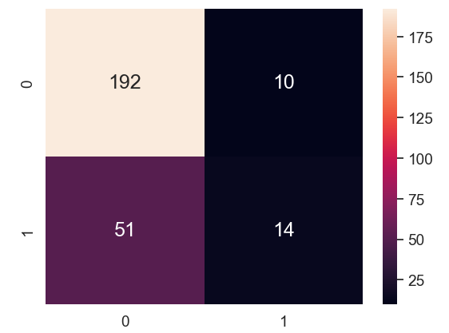
Random Forest
Notes:
We then proceeded to eliminate features directly indicating mental health symptoms to explore other significant factors associated with mental health issues. This led to a drop in the random forest model's accuracy from 0.94 to 0.82. While the false positive rate decreased from 19 out of 202 to 10 out of 202, the false negative rate increased from 24 out of 65 to 51 out of 65.
The findings suggest that excluding features directly related to mental health symptoms diminished the model's accuracy, indicating the importance of these features for accurate prediction. Despite the decrease in false positives, the increase in false negatives implies a higher likelihood of misclassifying individuals with mental health issues as non-affected. Moving on, we investigated whether the presence of evident mental health symptoms impacts employment status prediction using the random forest model. Initially, the model achieved an accuracy of 0.85, with 24 false positives out of 191 and 53 false negatives out of 76. Upon removing all employment-related features, the accuracy dropped to 0.79. While the false positive rate decreased slightly to 22 out of 191, the false negative rate increased to 56 out of 76.

Slide 12
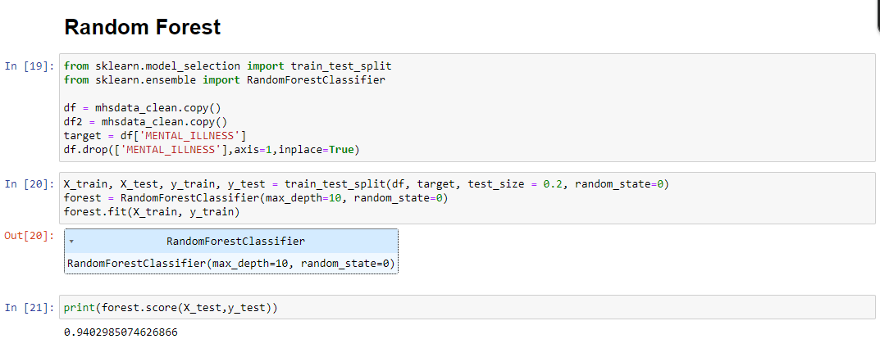
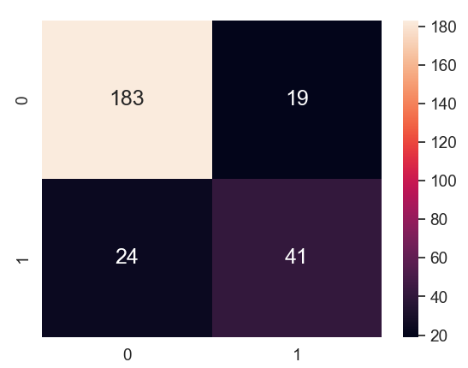
Random Forest
Notes:
Initially, we focused on the random forest model, which achieved an accuracy of 0.94. Subsequently, we constructed a confusion matrix to find out the false positive and false negative rates, revealing 24 false negatives out of 65 entries and 19 false positives out of 202 entries.

Slide 13
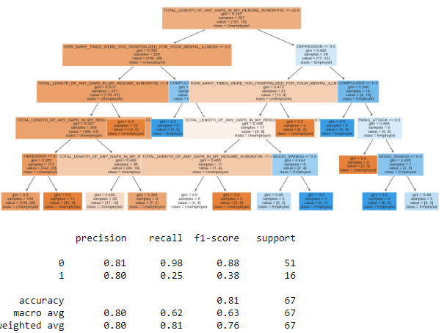
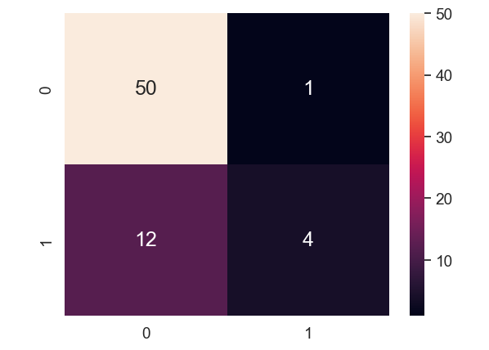
Dectree
Notes:
Moving on to the decision tree model, which was applied to the existing dataset, it demonstrated an initial accuracy of 0.81. This indicates that it accurately predicted around 81% of the cases in the test dataset.
However, upon closer examination through the confusion matrix, we observed a false positive rate of 1 out of 51 and a false negative rate of 12 out of 16.
The false positive rate of 1 out of 51 suggests that the model incorrectly classified one instance as positive when it belonged to the negative class. Conversely, the false negative rate of 12 out of 16 indicates that the model failed to identify 12 instances that belonged to the positive class.
These results imply that while the decision tree model achieved a relatively high overall accuracy, it still encountered challenges in correctly classifying instances, particularly with a notable number of false negatives. This indicates that the model may need further refinement or adjustments to improve its ability to accurately predict both positive and negative cases.

Slide 14
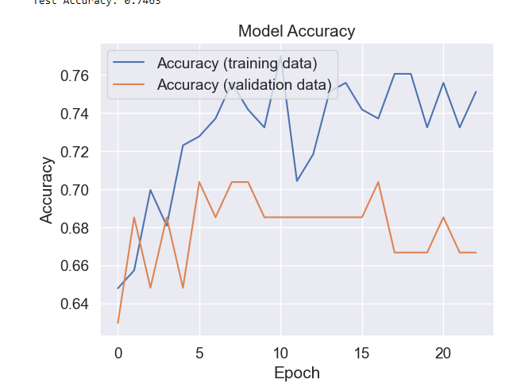
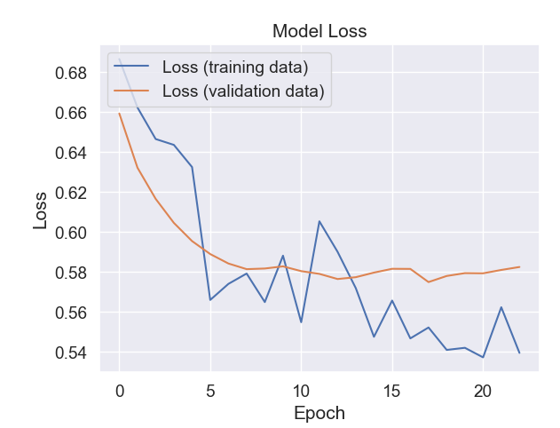
Neural Network
Notes:
Moving on to the neural network, we first established the setup by incorporating normalization to standardize the data with a mean of 0 and a standard deviation of 1 for ensuring neural network convergence. Dropout was implemented to prevent overfitting, and early stopping was employed to curb overtraining. Initially, the model started with an accuracy of 59.92% and a loss of 0.7276. Over subsequent epochs, the accuracy improved to 78.59%, while the loss decreased to 0.5228, indicating learning. Validation accuracy stabilized around 74%, while validation loss reached 0.5539 towards the end of training, hinting at a potential for overfitting. Testing against the test set yielded an accuracy of 73.13%, consistent with the validation accuracy, suggesting generalization of the model.
Subsequently, learning from the previous output, we adjusted the learning rate to enhance training stability, increasing patience accordingly. This modification led to the model starting with 58.07% accuracy and a loss of 0.6798, peaking at 79% accuracy at the 68th epoch. Validation accuracy began at 65.67% and peaked at 76.12%, indicating minimal improvement and hinting at a potential plateau. We aimed to create a new model to explore potential improvements in accuracy.
Incorporating batch normalization and RMSprop optimizer into the model, it commenced with 65.02% accuracy and a loss of 0.7035, peaking at 78.61% accuracy by the 13th epoch, signifying significant learning post-introduction of batch normalization and RMSprop. Testing against the test data resulted in an accuracy of 74.63%, the highest among all models thus far. Introducing L2 regularization further bolstered overall accuracy and reduced loss by mitigating overfitting through penalty addition to the loss function.
With a precision of 0.33 for predicting "1" (Employed), it suggests that while the model accurately predicts "0" (Unemployed) 77% of the time, it only identifies "Employed" 33% of the time. Additionally, with a low recall figure of 12% for "1", the model struggles to correctly identify actual "Employed" cases, indicating imbalanced learning due to the highly biased class distribution, which may have affected its performance. The confusion matrix accurately predicts 47 out of 51 unemployed individuals but misses 14 out of 16 employments, further highlighting the impact of class imbalance on learning.

Slide 15
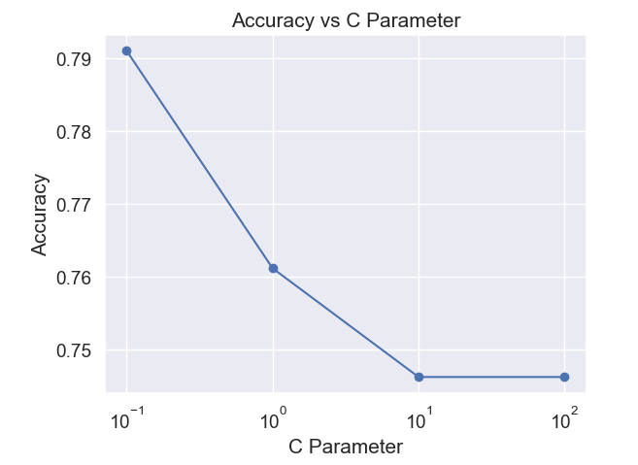
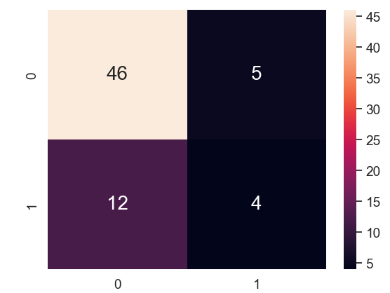
SVM
Notes:
Moving on to the neural network, we first established the setup by incorporating normalization to standardize the data with a mean of 0 and a standard deviation of 1 for ensuring neural network convergence. Dropout was implemented to prevent overfitting, and early stopping was employed to curb overtraining. Initially, the model started with an accuracy of 59.92% and a loss of 0.7276. Over subsequent epochs, the accuracy improved to 78.59%, while the loss decreased to 0.5228, indicating learning. Validation accuracy stabilized around 74%, while validation loss reached 0.5539 towards the end of training, hinting at a potential for overfitting. Testing against the test set yielded an accuracy of 73.13%, consistent with the validation accuracy, suggesting generalization of the model.
Subsequently, learning from the previous output, we adjusted the learning rate to enhance training stability, increasing patience accordingly. This modification led to the model starting with 58.07% accuracy and a loss of 0.6798, peaking at 79% accuracy at the 68th epoch. Validation accuracy began at 65.67% and peaked at 76.12%, indicating minimal improvement and hinting at a potential plateau. We aimed to create a new model to explore potential improvements in accuracy.
Incorporating batch normalization and RMSprop optimizer into the model, it commenced with 65.02% accuracy and a loss of 0.7035, peaking at 78.61% accuracy by the 13th epoch, signifying significant learning post-introduction of batch normalization and RMSprop. Testing against the test data resulted in an accuracy of 74.63%, the highest among all models thus far. Introducing L2 regularization further bolstered overall accuracy and reduced loss by mitigating overfitting through penalty addition to the loss function.
With a precision of 0.33 for predicting "1" (Employed), it suggests that while the model accurately predicts "0" (Unemployed) 77% of the time, it only identifies "Employed" 33% of the time. Additionally, with a low recall figure of 12% for "1", the model struggles to correctly identify actual "Employed" cases, indicating imbalanced learning due to the highly biased class distribution, which may have affected its performance. The confusion matrix accurately predicts 47 out of 51 unemployed individuals but misses 14 out of 16 employments, further highlighting the impact of class imbalance on learning.

Slide 16
Conclusion
Neural Network & Random Forest shown the best performance
Correlations were found
Certain age groups had more incidences
Gender could potentially be an important factor as well

Slide 17
Reference
https://www.channelnewsasia.com/singapore/singapore-struggle-mental-health-issues-stress-emotions-work-studies-wellness-3883091
https://www.ipsos.com/en-sg/singaporeans-deem-mental-health-biggest-health-problem#:~:text=Singaporeans'%20Top%20Health%20Concern%20-%20Mental,%25
https://www.kaggle.com/datasets/michaelacorley/unemployment-and-mental-illness-survey
https://www.simplilearn.com/tutorials/machine-learning-tutorial/random-forest-algorithm#:~:text=Step%201%3A%20Select%20random%20samples,as%20the%20final%20prediction%20result.
https://www.w3schools.com/python/python_ml_logistic_regression.asp
https://www.datacamp.com/tutorial/svm-classification-scikit-learn-python
https://www.analyticsvidhya.com/blog/2021/09/introduction-to-artificial-neural-networks/#:~:text=An%20Artificial%20Neural%20Network%20(ANN)%20is%20a%20machine%20learning%20model,learn%20patterns%20and%20make%20predictions.
https://medium.com/analytics-vidhya/confusion-matrix-accuracy-precision-recall-f1-score-ade299cf63cd
https://www.researchgate.net/figure/Calculation-of-Precision-Recall-and-Accuracy-in-the-confusion-matrix_fig3_336402347

